Slide 1
WELCOME TO
HANDS-ON MATHS

Slide 2
Let’s Try On Some Hands-On Activity

Slide 3

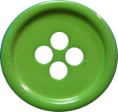
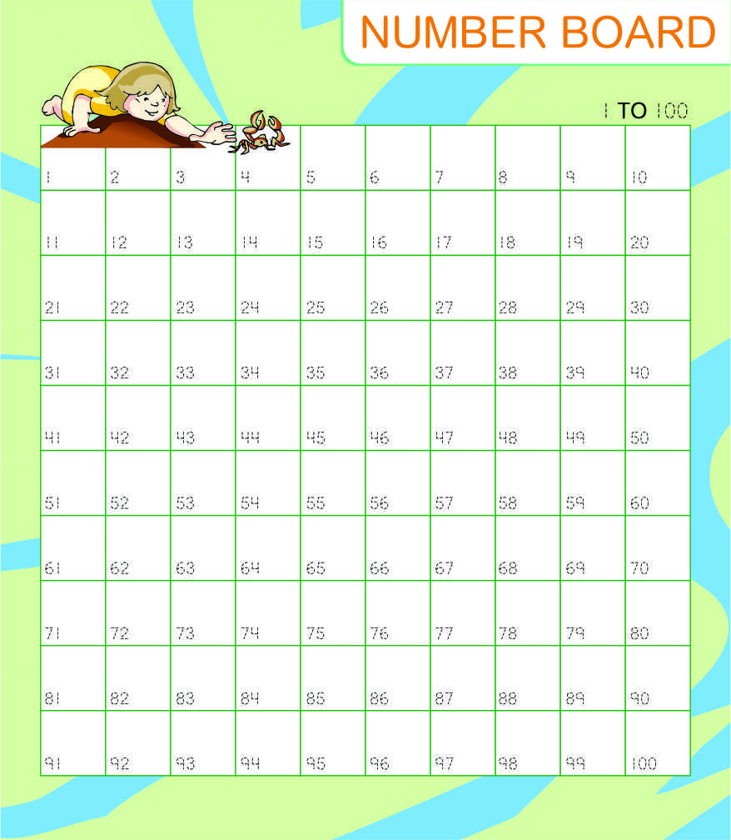
Please check if everybody has:
  10 red
Buttons
10 green
  1-100 Number Board

Slide 4
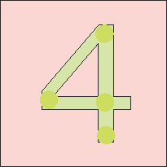
button on
Place a
and on every 4th number
thereafter.

Slide 6
On which numbers have you put the buttons?

Slide 7
The numbers are
  4, 8, 12, 16, 20, 24, 28, 32, 36, 40

Slide 8
What are these Numbers?

Slide 9
These numbers are
Multiples of Four

Slide 10
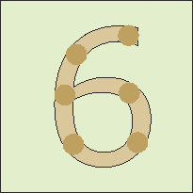
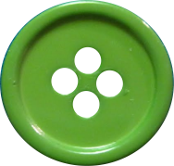
button on
Place a
and on every 6th number
thereafter.

Slide 11


Slide 12
On which numbers have you put the buttons now?

Slide 13
The numbers are
  6, 12, 18, 24, 30, 36, 42, 48, 54, 60

Slide 14
Are there some numbers on which both colour buttons have been put?

Slide 15
?
?

Slide 16
Yes, the numbers are:
  12 24 36

Slide 17
What are these Numbers called?

Slide 18
The numbers are
Common Multiples
as they are common to multiples of both 4 and 6…

Slide 19
Which is the smallest or the lowest of these common multiples:
12, 24, 36, etc…?

Slide 20
  12
Voila! 12 is the lowest common multiple as this is the smallest of the common multiples of 4 and 6.

Slide 21
Least Common Multiple is also abbreviated as:
L.C.M.

Slide 22
Hands-on Activities in Mathematics
Take the phobia out of the subject
Make concepts clear
Enhance learning
Enhance creative skills
Enhance critical thinking competencies
Make subject enjoyable

Slide 23
From a famous Chinese proverb
You TELL me & I will FORGET
You SHOW me & I will REMEMBER
You Make me DO & I will UNDERSTAND

Slide 24
And Going
A Step
Further…

Slide 25
As another saying goes:
Practice Makes Perfect

Slide 26
Help me PRACTICE
& I Will EXCEL!

Slide 27
  Thank you
  Very Much!

